Slide 1
Slalom
AIMS Lab

Slide 2
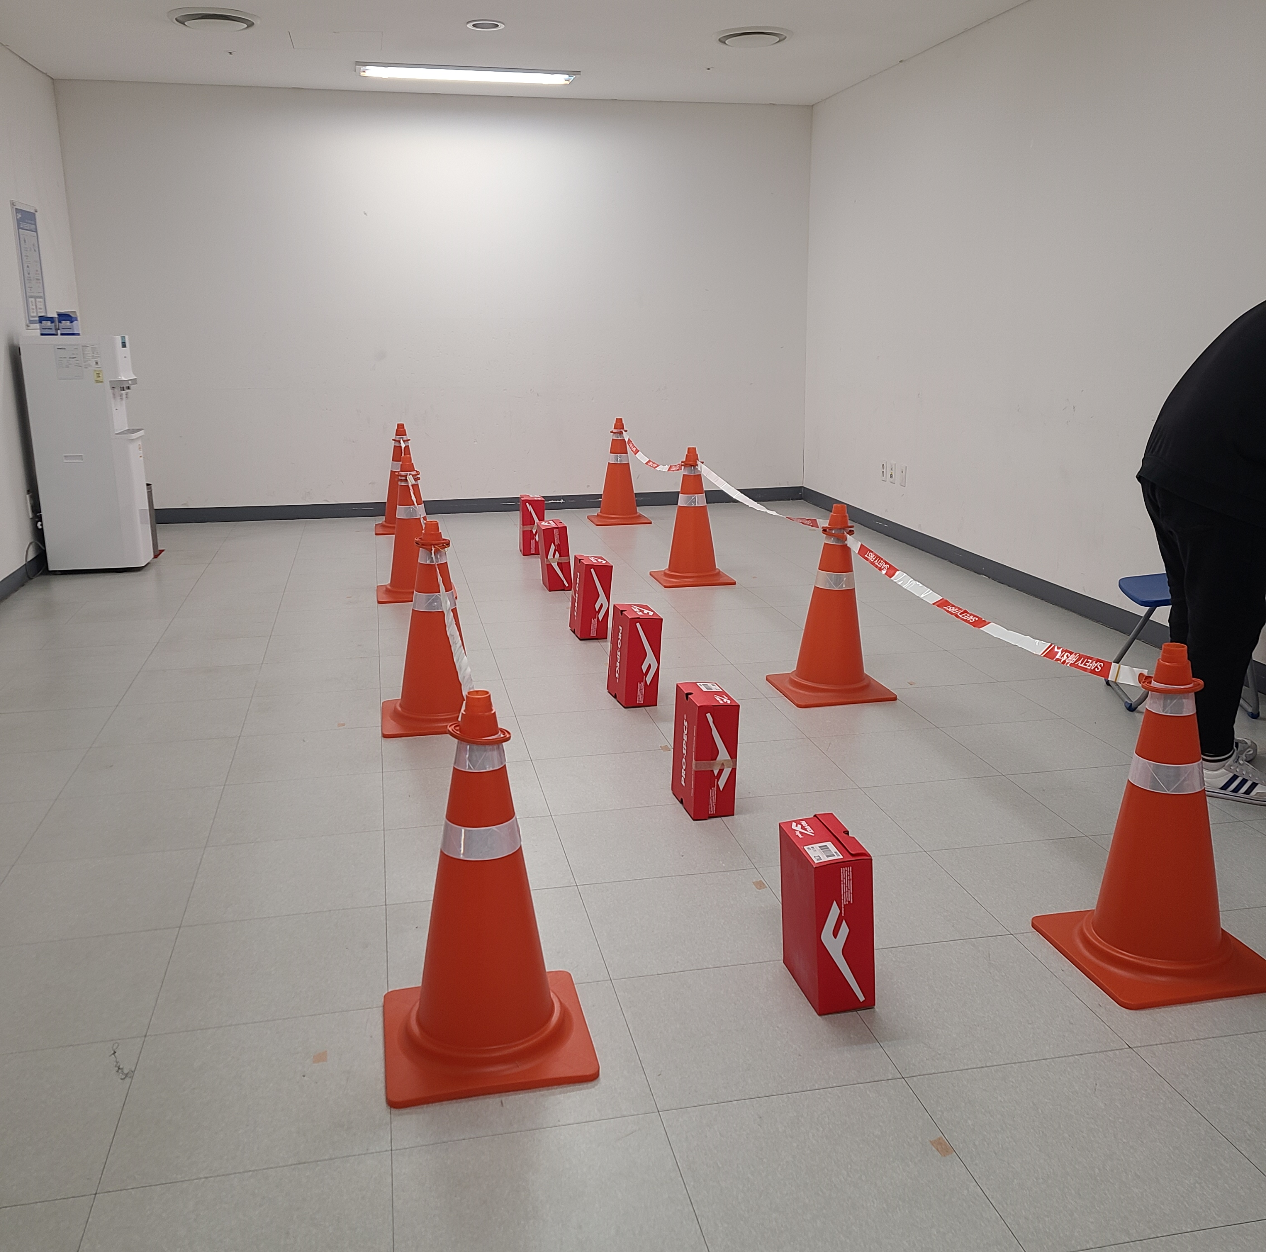
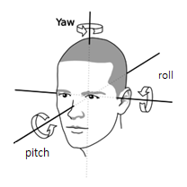
Data
- parameter(Angle, FSR, IMU) - Slalom 보행 데이터
- HS_parameter(Angle, FSR, IMU) - Heel strike index
X-axis angle : Pitch
Y-axis angle : Roll
Z-axis angle : Yaw
Sampling Rate : 75 Hz
Gap / Constrain
1m (1m, 1.5m, 2m) - 25trial x 3 = 75trials
1.5m (1m, 1.5m, 2m) - 20trial x 3 = 60trials
2m (1m, 1.5m, 2m) - 15trial x 3 = 45trials
Normal gait- 20trials
(3 x 3) x 2 (L,R) + 2 = 20 category
Total- 220trials

Slide 3
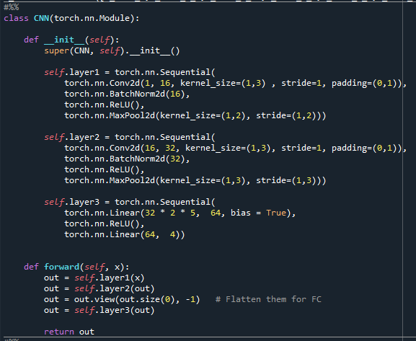
CNN
CNN
Hyperparameter
Learning rate : 0.03
Batch size : 64
Weight_Decay : 0.0001
Epoch : 200
Window size : 0.4s
Train : Test = 4 : 1
Convolution
BatchNorm
MaxPool
Convolution
BatchNorm
MaxPool
FC layer
Dense layer

Slide 4
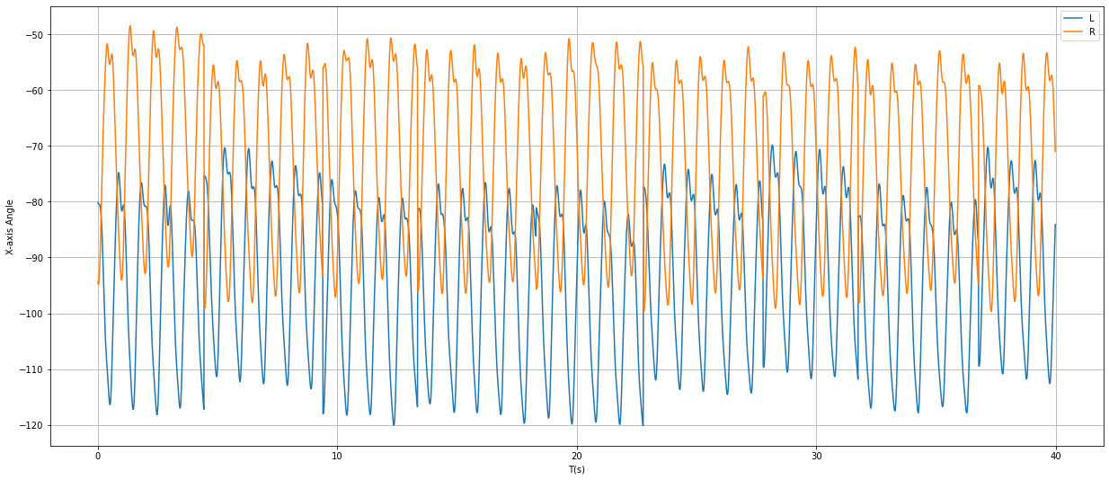
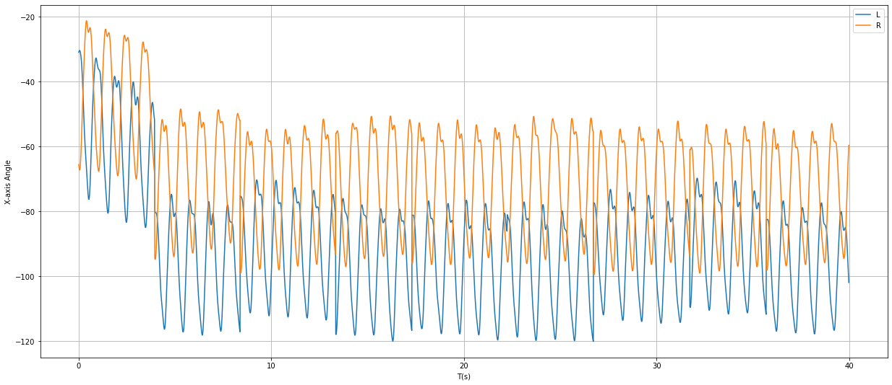
데이터 정리
1st trial 절삭 후
Raw data
Sub 6,8,9,10의 normal walking 1st trial에서 이상데이터 절삭

Slide 5
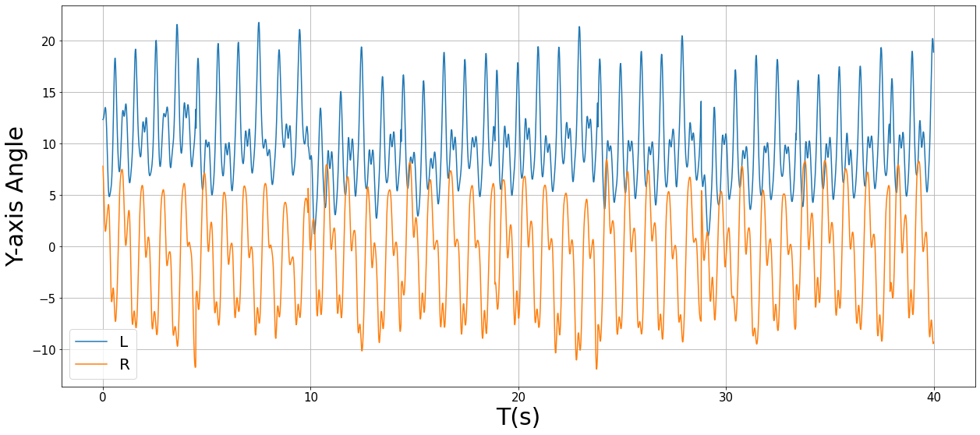
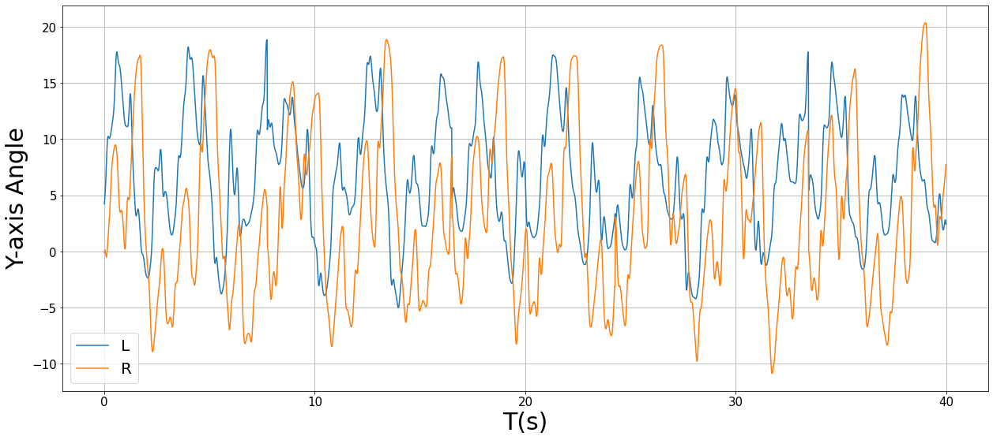
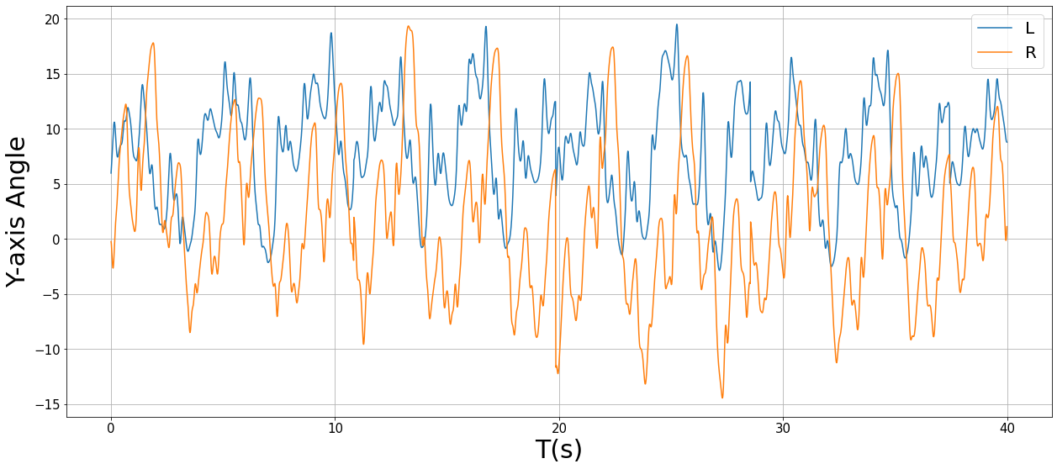
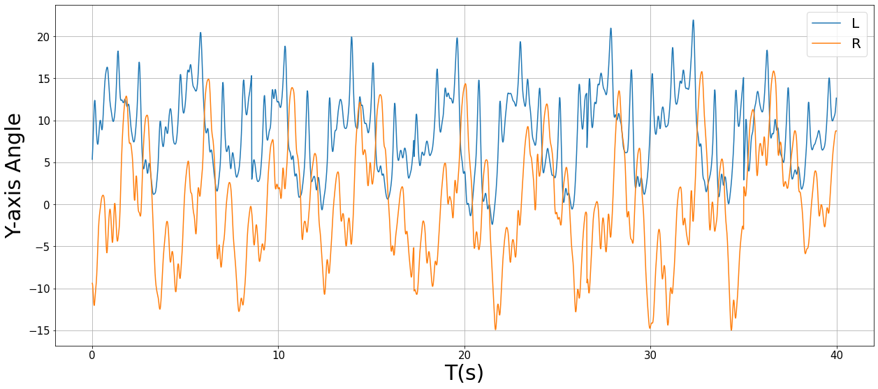
Roll(Y-axis) Angle Raw data plot (Sub1)
Normal walking
1m gap 100cm constrain
1m gap 150cm constrain
1m gap 200cm constrain

Slide 6
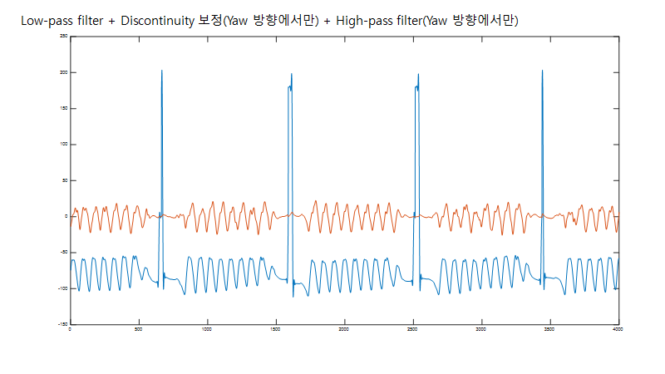
(Yaw) Z-axis 필터링
Yaw에서 발생한 필터링 에러를 보정해서 다시 데이터를 받음

Slide 7
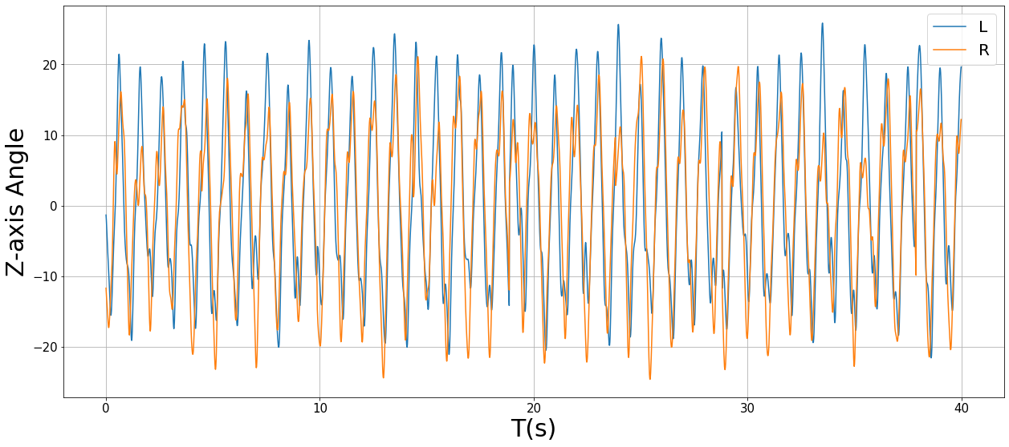
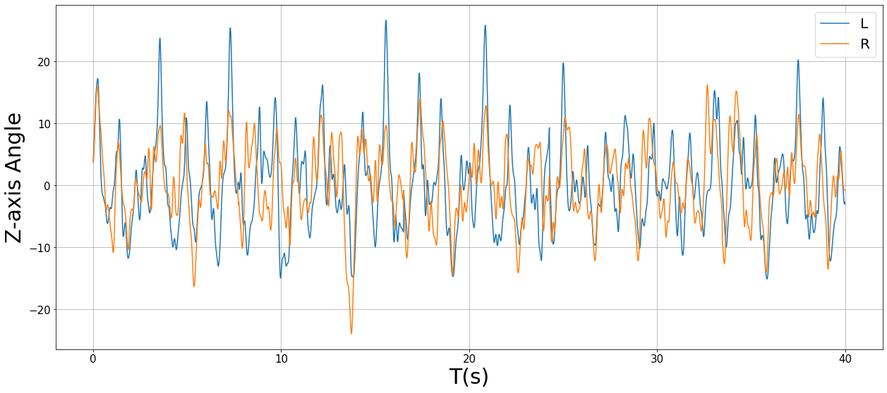
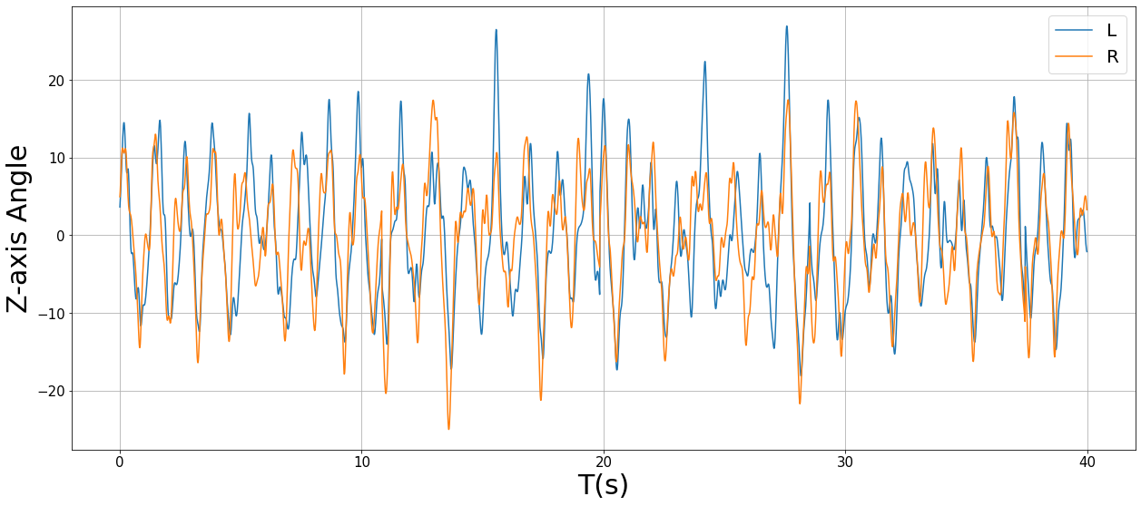
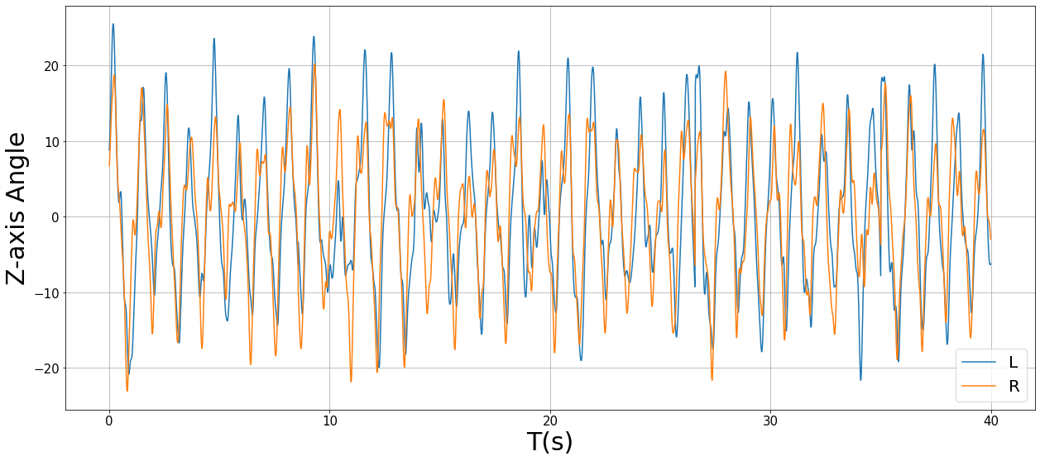
Yaw(Z-axis) Angle Raw data plot (Sub1)
Normal walking
1m gap 100cm constrain
1m gap 150cm constrain
1m gap 200cm constrain

Slide 8
nRMSE(%) for Sub 1
dqweqw
<= RMSE 5%
Pitch+Roll | C1 : L | C1 : R | C1.5 : L | C1.5 : R | C2 : L | C2 : R
G1 | 0.0412 | 0.045 | 0.0309 | 0.0298 | 0.027 | 0.0234
G1.5 | 0.0322 | 0.0328 | 0.0213 | 0.0253 | 0.0204 | 0.0228
G2 | 0.0292 | 0.0288 | 0.0272 | 0.0284 | 0.0223 | 0.0221
Normal | 0.0184 | 0.0203 | LAVG | 0.027 | RAVG | 0.0306
Pitch | C1 : L | C1 : R | C1.5 : L | C1.5 : R | C2 : L | C2 : R
G1 | 0.0425 | 0.0475 | 0.0354 | 0.0329 | 0.0293 | 0.0307
G1.5 | 0.0379 | 0.0371 | 0.0263 | 0.0311 | 0.0229 | 0.0246
G2 | 0.0322 | 0.0315 | 0.0308 | 0.0317 | 0.0234 | 0.023
Normal | 0.033 | 0.0232 | LAVG | 0.0314 | RAVG | 0.0345
Roll+Yaw | C1 : L | C1 : R | C1.5 : L | C1.5 : R | C2 : L | C2 : R
G1 | 0.1057 | 0.1111 | 0.0527 | 0.0508 | 0.0359 | 0.0347
G1.5 | 0.0506 | 0.0515 | 0.0331 | 0.0366 | 0.0338 | 0.0317
G2 | 0.0431 | 0.043 | 0.0397 | 0.0387 | 0.0331 | 0.031
Normal | 0.0348 | 0.0366 | LAVG | 0.0462 | RAVG | 0.0512
Roll | C1 : L | C1 : R | C1.5 : L | C1.5 : R | C2 : L | C2 : R
G1 | 0.0749 | 0.0814 | 0.0483 | 0.0455 | 0.038 | 0.0363
G1.5 | 0.0459 | 0.0477 | 0.0316 | 0.0348 | 0.0307 | 0.0324
G2 | 0.0423 | 0.0422 | 0.0347 | 0.0354 | 0.0316 | 0.0292
Normal | 0.0343 | 0.0347 | LAVG | 0.0412 | RAVG | 0.0461
Yaw+Pitch | C1 : L | C1 : R | C1.5 : L | C1.5 : R | C2 : L | C2 : R
G1 | 0.046 | 0.0531 | 0.0345 | 0.0348 | 0.0279 | 0.027
G1.5 | 0.0341 | 0.0346 | 0.0223 | 0.0271 | 0.0226 | 0.0233
G2 | 0.0301 | 0.0302 | 0.03 | 0.0306 | 0.023 | 0.0226
Normal | 0.0244 | 0.0232 | LAVG | 0.0295 | RAVG | 0.0336
Yaw | C1 : L | C1 : R | C1.5 : L | C1.5 : R | C2 : L | C2 : R
G1 | 0.2413 | 0.2434 | 0.1182 | 0.1176 | 0.0647 | 0.0606
G1.5 | 0.1374 | 0.1408 | 0.0889 | 0.0925 | 0.0551 | 0.056
G2 | 0.1417 | 0.1435 | 0.1122 | 0.1083 | 0.0821 | 0.0805
Normal | 0.0952 | 0.0662 | LAVG | 0.1137 | RAVG | 0.1223
Pitch+Roll+Yaw | C1 : L | C1 : R | C1.5 : L | C1.5 : R | C2 : L | C2 : R
G1 | 0.0474 | 0.0551 | 0.0333 | 0.0315 | 0.0259 | 0.0227
G1.5 | 0.0318 | 0.0354 | 0.0217 | 0.0269 | 0.0251 | 0.0244
G2 | 0.0324 | 0.0331 | 0.0268 | 0.0298 | 0.0237 | 0.0249
Normal | 0.024 | 0.022 | LAVG | 0.0292 | RAVG | 0.0335
LAVG : Pitch+Roll > Pitch+Roll+Yaw = Yaw+Pitch > Pitch > Roll > Roll+Yaw > Yaw
RAVG : Pitch+Roll > Pitch+Roll+Yaw = Yaw+Pitch > Pitch > Roll > Roll+Yaw > Yaw

Slide 9
nRMSE(%) for Sub 5
Pitch+Roll | C1 : L | C1 : R | C1.5 : L | C1.5 : R | C2 : L | C2 : R
G1 | 0.0545 | 0.0367 | 0.0286 | 0.0252 | 0.0252 | 0.0243
G1.5 | 0.0476 | 0.0457 | 0.0313 | 0.0266 | 0.0507 | 0.049
G2 | 0.0406 | 0.0371 | 0.086 | 0.0837 | 0.0236 | 0.0216
Normal | 0.0263 | 0.0268 | LAVG | 0.0414 | RAVG | 0.0418
Pitch | C1 : L | C1 : R | C1.5 : L | C1.5 : R | C2 : L | C2 : R
G1 | 0.064 | 0.0438 | 0.0359 | 0.0315 | 0.0265 | 0.0231
G1.5 | 0.0444 | 0.0441 | 0.0283 | 0.0234 | 0.0461 | 0.0461
G2 | 0.0415 | 0.0339 | 0.079 | 0.0798 | 0.0313 | 0.0279
Normal | 0.0355 | 0.0379 | LAVG | 0.0432 | RAVG | 0.0435
Roll+Yaw | C1 : L | C1 : R | C1.5 : L | C1.5 : R | C2 : L | C2 : R
G1 | 0.0736 | 0.0611 | 0.0428 | 0.0394 | 0.0349 | 0.0349
G1.5 | 0.065 | 0.0605 | 0.0426 | 0.0364 | 0.0519 | 0.0496
G2 | 0.0504 | 0.0453 | 0.0872 | 0.0858 | 0.0327 | 0.0315
Normal | 0.0406 | 0.0452 | LAVG | 0.0522 | RAVG | 0.0542
Roll | C1 : L | C1 : R | C1.5 : L | C1.5 : R | C2 : L | C2 : R
G1 | 0.0877 | 0.075 | 0.0512 | 0.0479 | 0.0481 | 0.046
G1.5 | 0.0692 | 0.0669 | 0.0389 | 0.0379 | 0.0522 | 0.0512
G2 | 0.0538 | 0.0495 | 0.0859 | 0.085 | 0.0416 | 0.0388
Normal | 0.0544 | 0.0558 | LAVG | 0.0583 | RAVG | 0.0612
Yaw+Pitch | C1 : L | C1 : R | C1.5 : L | C1.5 : R | C2 : L | C2 : R
G1 | 0.0527 | 0.037 | 0.0286 | 0.0254 | 0.0258 | 0.0228
G1.5 | 0.0508 | 0.0464 | 0.0346 | 0.0281 | 0.0548 | 0.0525
G2 | 0.043 | 0.0375 | 0.0896 | 0.088 | 0.0254 | 0.0226
Normal | 0.0294 | 0.0322 | LAVG | 0.0435 | RAVG | 0.0436
Yaw | C1 : L | C1 : R | C1.5 : L | C1.5 : R | C2 : L | C2 : R
G1 | 0.1362 | 0.1238 | 0.0573 | 0.0538 | 0.0416 | 0.0393
G1.5 | 0.1008 | 0.0937 | 0.0664 | 0.0594 | 0.0641 | 0.0632
G2 | 0.0861 | 0.0823 | 0.1021 | 0.1003 | 0.0554 | 0.0516
Normal | 0.073 | 0.0742 | LAVG | 0.0783 | RAVG | 0.082
Pitch+Roll+Yaw | C1 : L | C1 : R | C1.5 : L | C1.5 : R | C2 : L | C2 : R
G1 | 0.0538 | 0.0402 | 0.0295 | 0.0267 | 0.0252 | 0.0239
G1.5 | 0.0448 | 0.0462 | 0.0317 | 0.0269 | 0.0489 | 0.0473
G2 | 0.0382 | 0.0359 | 0.0816 | 0.0802 | 0.0249 | 0.0235
Normal | 0.024 | 0.025 | LAVG | 0.0403 | RAVG | 0.0416
LAVG : Pitch+Roll+Yaw = Pitch+Roll > Pitch = Yaw+Pitch > Roll+Yaw > Roll > Yaw
RAVG : Pitch+Roll+Yaw = Pitch+Roll > Pitch = Yaw+Pitch > Roll+Yaw > Roll > Yaw

Slide 10
nRMSE(%) for Sub 8
Pitch+Roll | C1 : L | C1 : R | C1.5 : L | C1.5 : R | C2 : L | C2 : R
G1 | 0.0343 | 0.0358 | 0.018 | 0.0181 | 0.0166 | 0.0186
G1.5 | 0.0359 | 0.0366 | 0.0153 | 0.0194 | 0.0179 | 0.0157
G2 | 0.0303 | 0.0302 | 0.0223 | 0.0254 | 0.0243 | 0.0259
Normal | 0.0154 | 0.015 | LAVG | 0.023 | RAVG | 0.0264
Pitch | C1 : L | C1 : R | C1.5 : L | C1.5 : R | C2 : L | C2 : R
G1 | 0.0347 | 0.0381 | 0.0223 | 0.0221 | 0.019 | 0.0204
G1.5 | 0.0392 | 0.0366 | 0.0192 | 0.0243 | 0.0185 | 0.021
G2 | 0.0373 | 0.0355 | 0.0266 | 0.0317 | 0.0224 | 0.0266
Normal | 0.0194 | 0.0205 | LAVG | 0.0259 | RAVG | 0.0303
Roll+Yaw | C1 : L | C1 : R | C1.5 : L | C1.5 : R | C2 : L | C2 : R
G1 | 0.0624 | 0.0591 | 0.0319 | 0.0324 | 0.0318 | 0.0351
G1.5 | 0.0702 | 0.0692 | 0.0367 | 0.0394 | 0.0313 | 0.0325
G2 | 0.0726 | 0.0728 | 0.0459 | 0.0475 | 0.0386 | 0.0403
Normal | 0.0232 | 0.024 | LAVG | 0.0445 | RAVG | 0.0497
Roll | C1 : L | C1 : R | C1.5 : L | C1.5 : R | C2 : L | C2 : R
G1 | 0.0572 | 0.0558 | 0.0337 | 0.0341 | 0.0343 | 0.0374
G1.5 | 0.0768 | 0.0742 | 0.0364 | 0.039 | 0.0313 | 0.0299
G2 | 0.0587 | 0.0608 | 0.0486 | 0.0516 | 0.0377 | 0.0398
Normal | 0.0317 | 0.0327 | LAVG | 0.0446 | RAVG | 0.05
Yaw+Pitch | C1 : L | C1 : R | C1.5 : L | C1.5 : R | C2 : L | C2 : R
G1 | 0.0364 | 0.0384 | 0.0228 | 0.0202 | 0.0174 | 0.0201
G1.5 | 0.037 | 0.0355 | 0.0193 | 0.0223 | 0.0193 | 0.0166
G2 | 0.0343 | 0.0328 | 0.0251 | 0.0288 | 0.0254 | 0.0278
Normal | 0.0174 | 0.0163 | LAVG | 0.0254 | RAVG | 0.0284
Yaw | C1 : L | C1 : R | C1.5 : L | C1.5 : R | C2 : L | C2 : R
G1 | 0.2175 | 0.2147 | 0.1371 | 0.1364 | 0.1181 | 0.116
G1.5 | 0.2189 | 0.2162 | 0.1305 | 0.1291 | 0.112 | 0.1121
G2 | 0.2225 | 0.2177 | 0.1639 | 0.1641 | 0.1089 | 0.1087
Normal | 0.0551 | 0.053 | LAVG | 0.1485 | RAVG | 0.1617
Pitch+Roll+Yaw | C1 : L | C1 : R | C1.5 : L | C1.5 : R | C2 : L | C2 : R
G1 | 0.036 | 0.038 | 0.0196 | 0.0209 | 0.0187 | 0.0207
G1.5 | 0.0388 | 0.0377 | 0.0173 | 0.0205 | 0.0211 | 0.0202
G2 | 0.0313 | 0.0378 | 0.0241 | 0.0271 | 0.0242 | 0.0276
Normal | 0.0204 | 0.0221 | LAVG | 0.0252 | RAVG | 0.0298
LAVG : Pitch+Roll > Pitch+Roll+Yaw = Yaw+Pitch = Pitch > Roll+Yaw = Roll > Yaw
RAVG : Pitch+Roll > Yaw+Pitch > Pitch+Roll+Yaw = Pitch > Roll+Yaw = Roll > Yaw

